Slide 1

IEEE PELS PELS Standards Overview of ETTC & IEC TC51 Standards for Magnetic Core Loss Testing
2023 August 17
Energy Innovation Center, Pittsburgh, PA

Slide 2
Background Info on Working Groups (ETTC Vs IEC TC51)
Electronics Transformers Technical Committee (ETTC)
Low Power: P_{OUT} ≤ 10 Kilo-watts
Wide Frequency: (F > 1 Hz)
Low Voltage: V_{WORKING} <1 kV
IEC TC51- Magnetic components, ferrite and magnetic powder material
Focus on higher frequencies: F ≥10 kHz
Lower currents: I ≤ 125A
Lower voltages: V_{WORKING} <1 kV
To prepare standards relating to:
parts and components displaying magnetic properties and intended for electronics in a wide range of application areas, including telecommunications, computers, automotive, aircraft, audio-visual, digital camera, lighting, solar and wind power systems, welding, inductive heating, power conditioning (UPS), wireless charging, RFID and medical;
parts associated with such components;
measuring methods and tests, and specifications for transformers and inductors using such components;
ferrite and magnetic powder materials.

Slide 3
IEEE PELS ETTC / IEC TC51 (Active Standards Reference For Core Loss testing)
IEEE-393 Procedure for Testing Magnetic Cores
Updated standard targeted for 2025Q1
IEC62024-3 ED1: High frequency inductive components – Electrical characteristics and measuring methods – Part 3: AC loss measured by sinusoidal wave of inductors for DC-to-DC converters
Publication targeted for 2026Q1
IEC62044-3 ED2: Cores made of soft magnetic materials measuring methods – Part 3: Magnetic properties at high excitation levels
ED2 to be published 2023Q3
IEC63300 Test methods for electrical and magnetic properties of magnetic cores
To be published 2023Q3

Slide 4
Standards for Magnetic Characterization (Material Vs Core Vs Component)
Material
Comparisons Between Materials Not Structures
Toroids of Fixed Physical Dimensions
Sized to Avoid Impact of Physical Dimensions, etc.,
For example, ratio of outside diameter to inside diameter
Test Coils Turns and Conductor Size, Distribution of Winding
Closed Magnetic Path
Continuous Magnetic Path - No Discrete or Intrinsic Physical Air Gaps
Core
Specific to Magnetic Material, Structure, Physical Dimensions, Gap
Specific to Test Coils
Agreed upon test coils
Fill factors
Leakage flux
Impact of Discrete Physical Air Gaps, Intrinsic Air Gaps and Distributed Air Gaps

Slide 5
Standards for Magnetic Characterization (Core Vs Component)
Core
Specific to Magnetic Material, Structure, Physical Dimensions, Gap
Specific to Test Coils
Agreed upon test coils
Fill factors
Leakage flux
Impact of Discrete Physical Air Gaps, Intrinsic Gaps and Distributed Air Gaps
Component
Total Power Loss
Specific to Component Fabrication
In most cases different from test coils used for measurements of core parameters
Coil Contribution On Power Loss Measurements
Fringing
Leakage flux
Impact of discrete physical air gaps

Slide 6
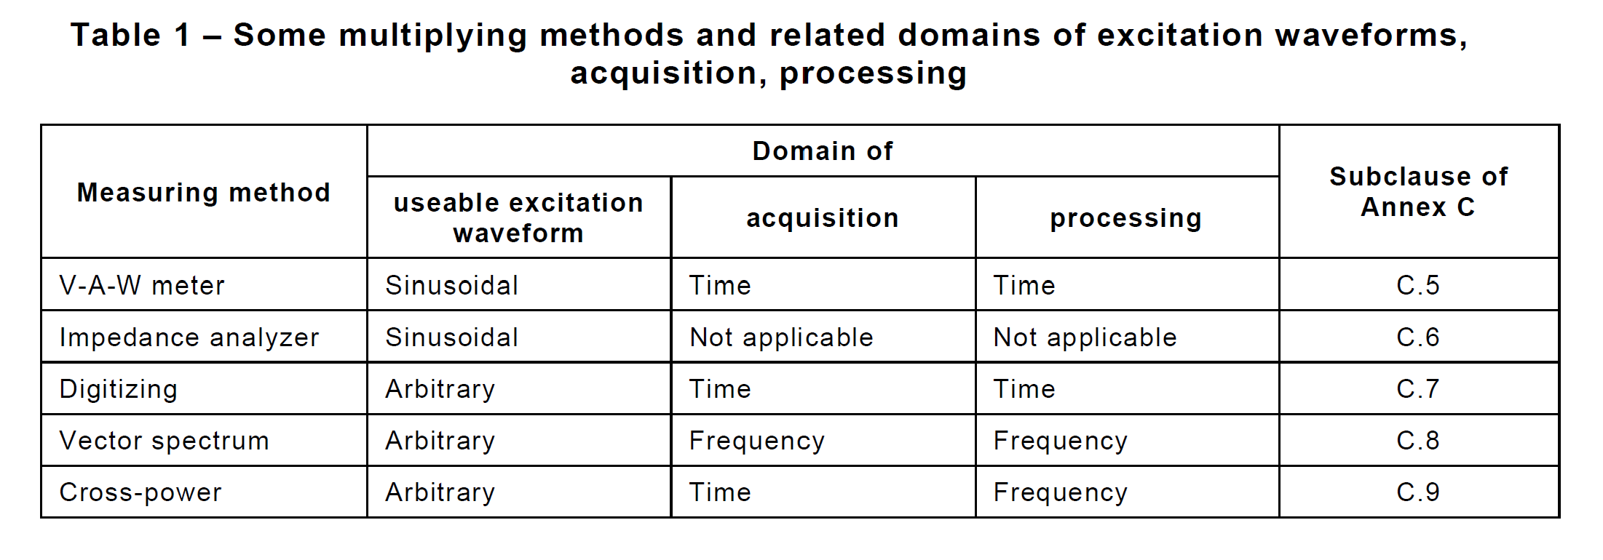
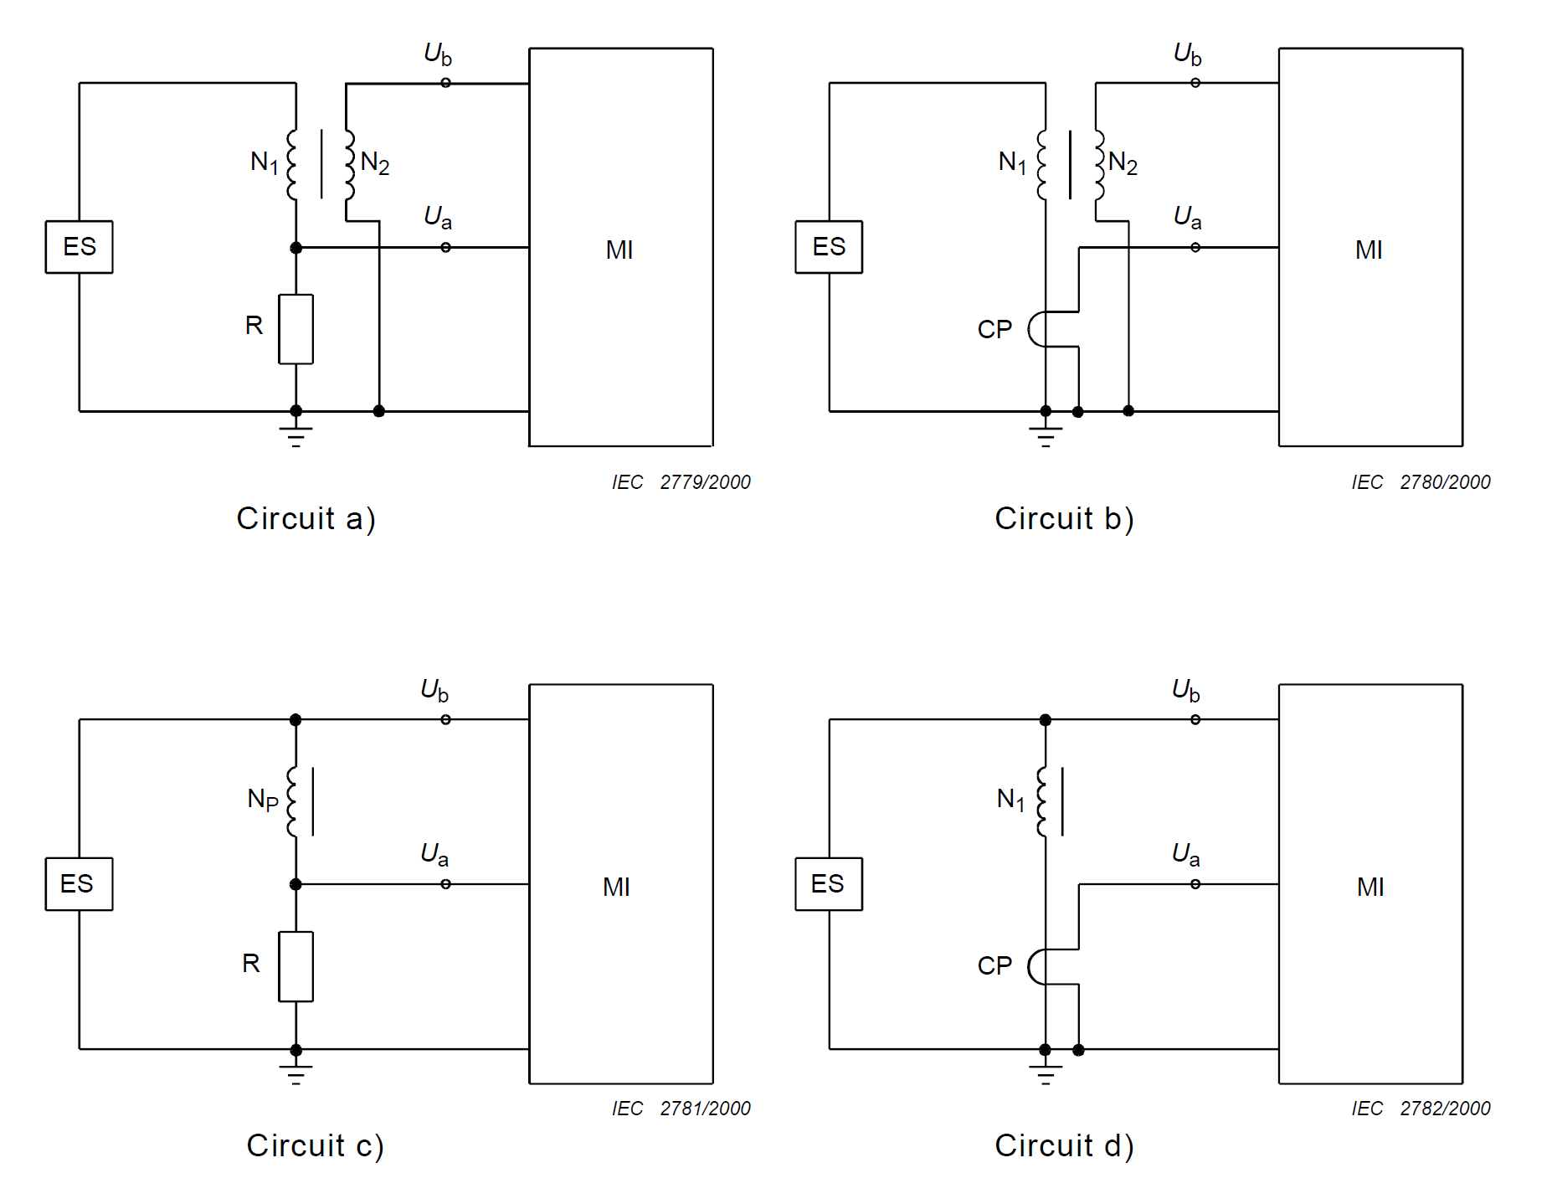
IEC 62044-3 ED1 (Magnetic properties at high excitation level)

Slide 7
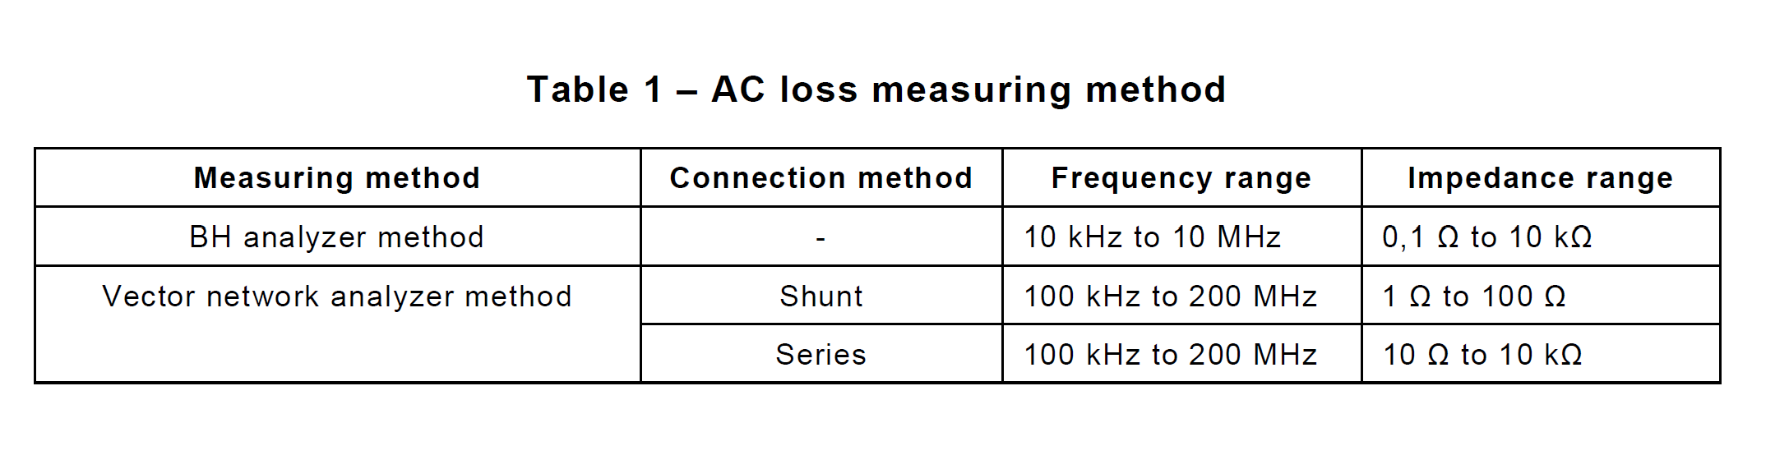
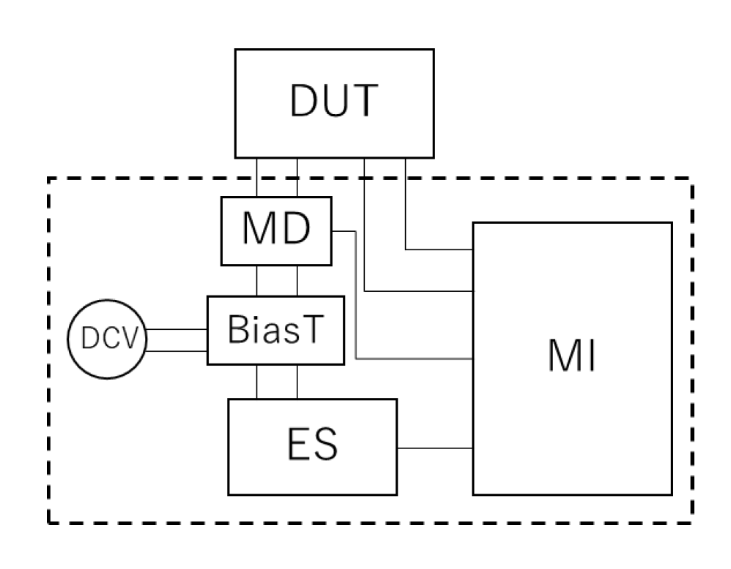
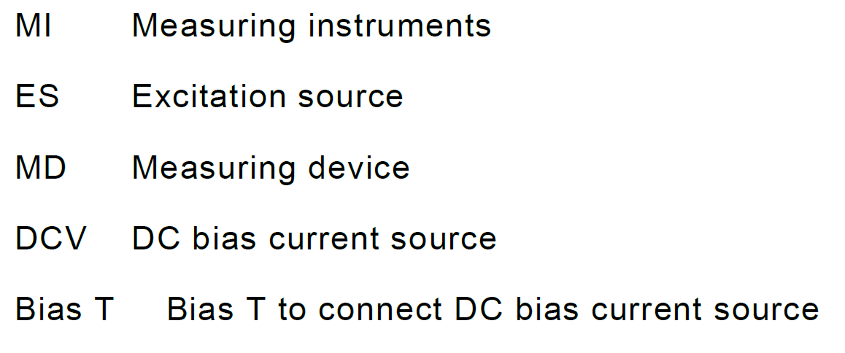
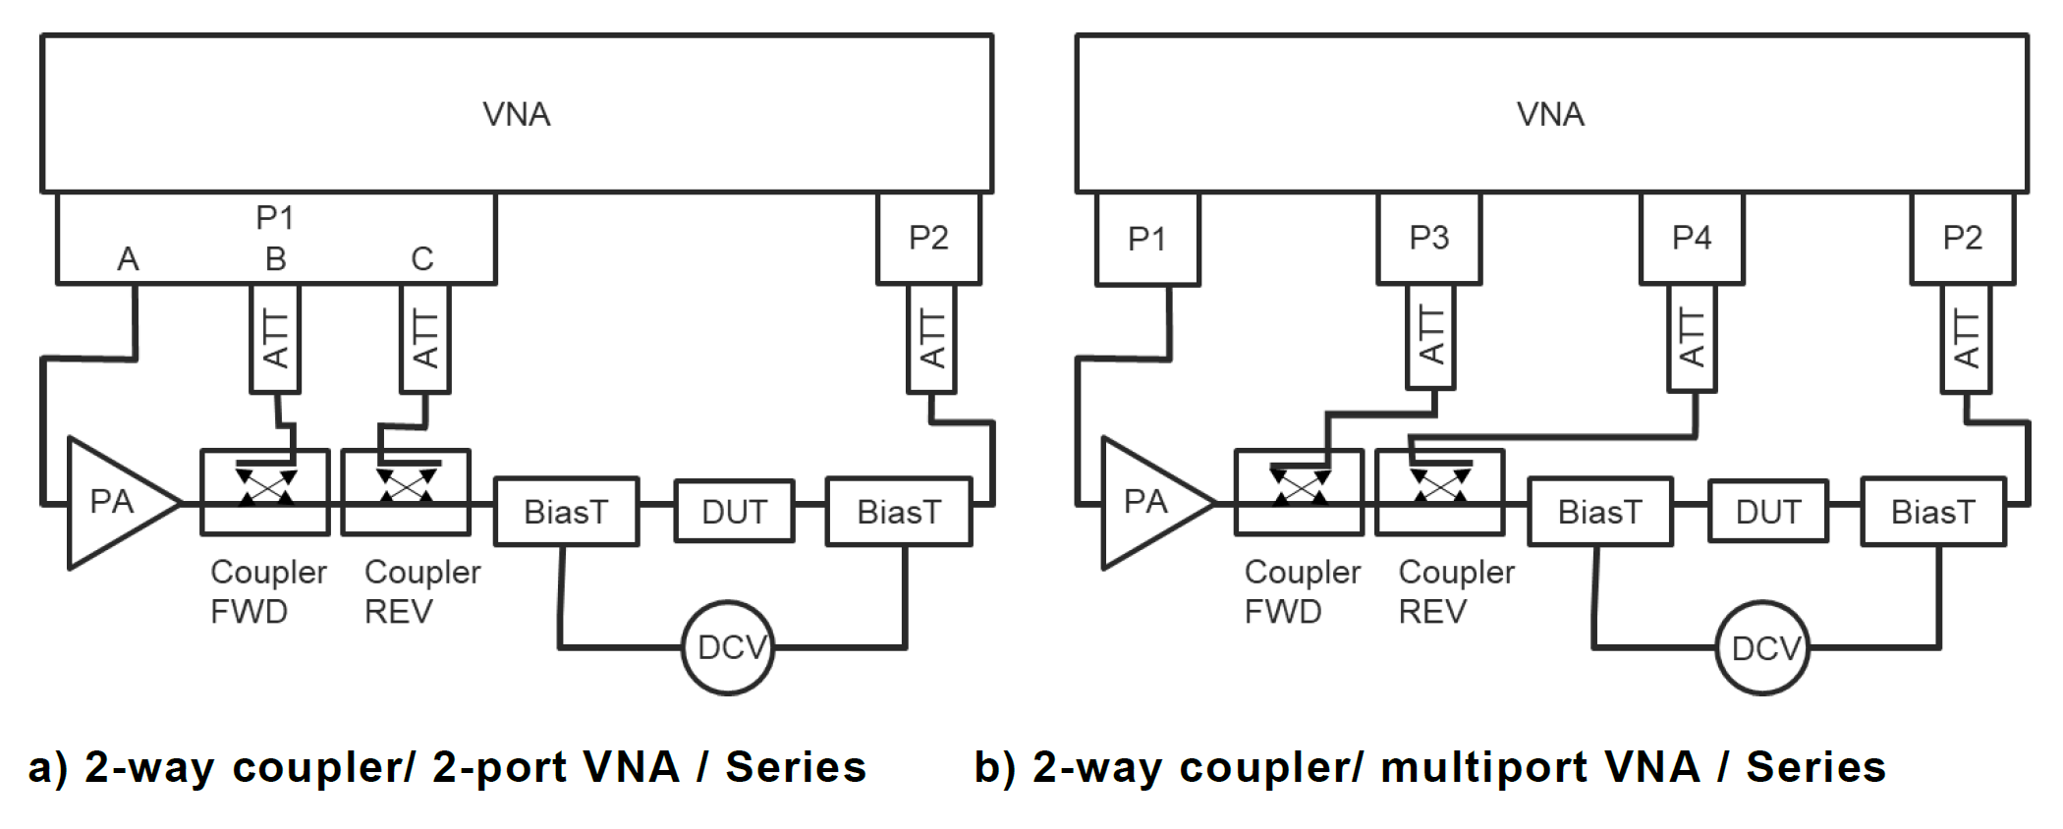
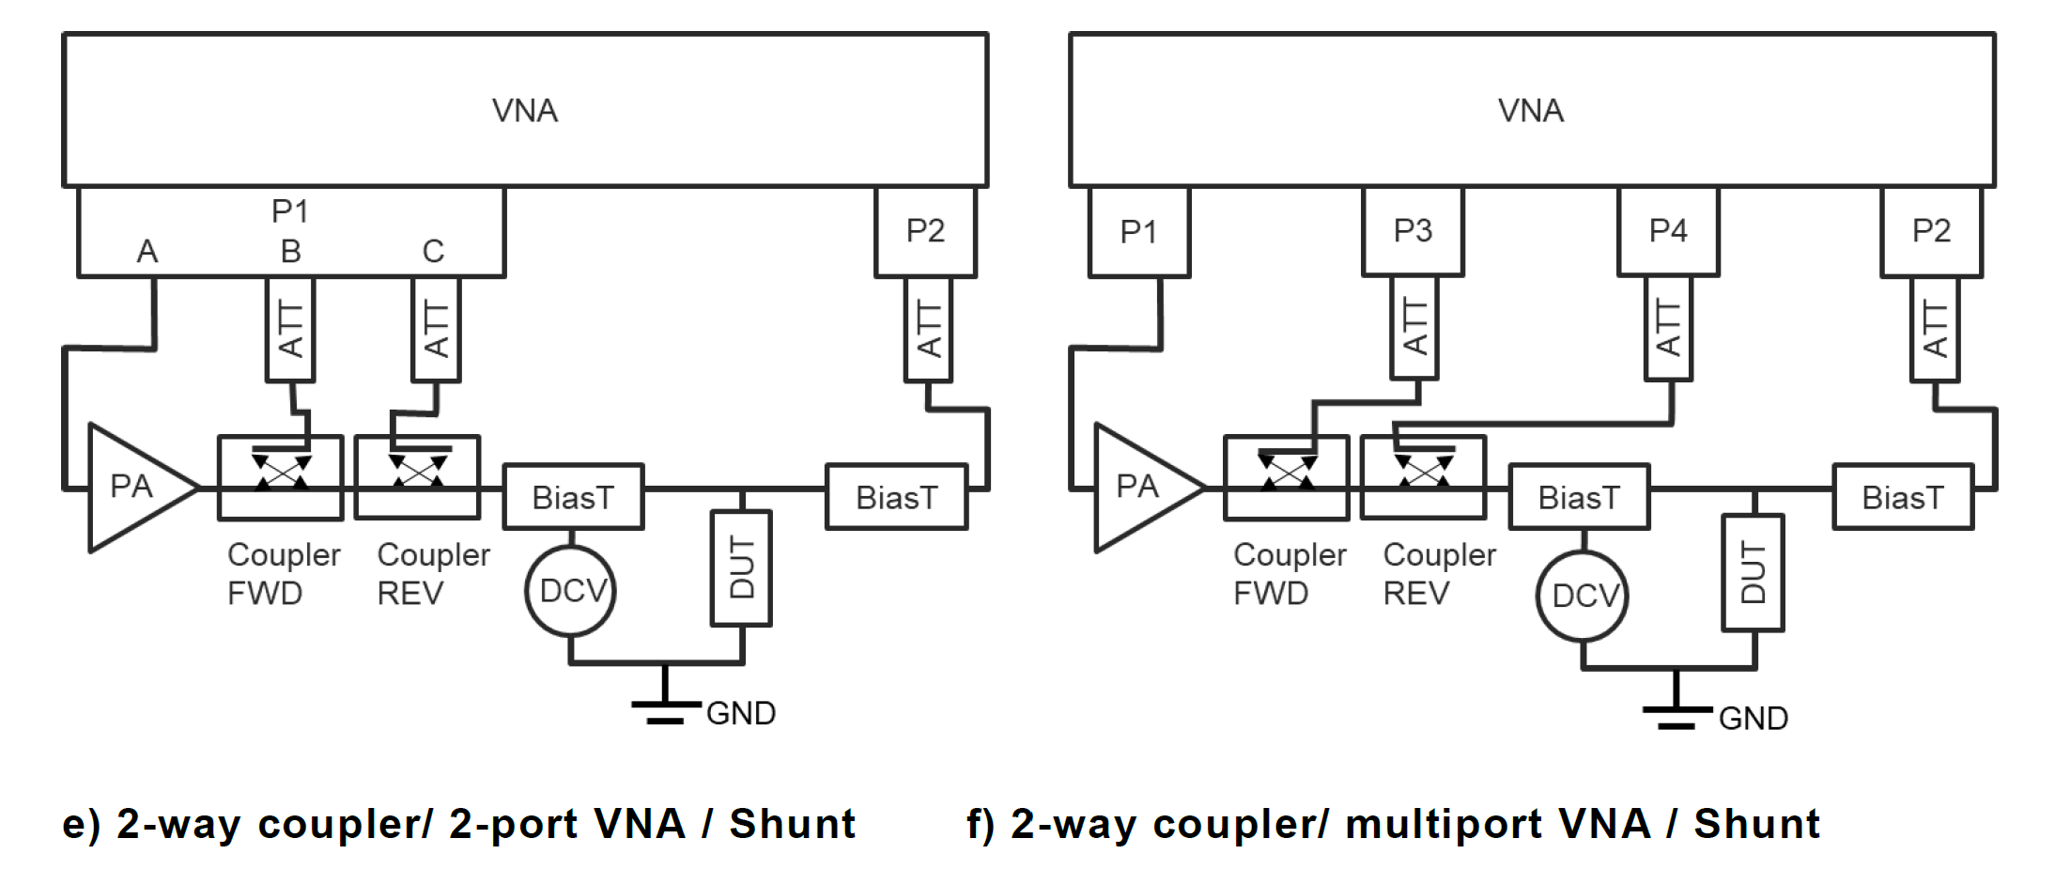
IEC 62024-3 ED1 (AC loss measured by sinusoidal wave of inductors for DC-DC Converters)

Slide 8
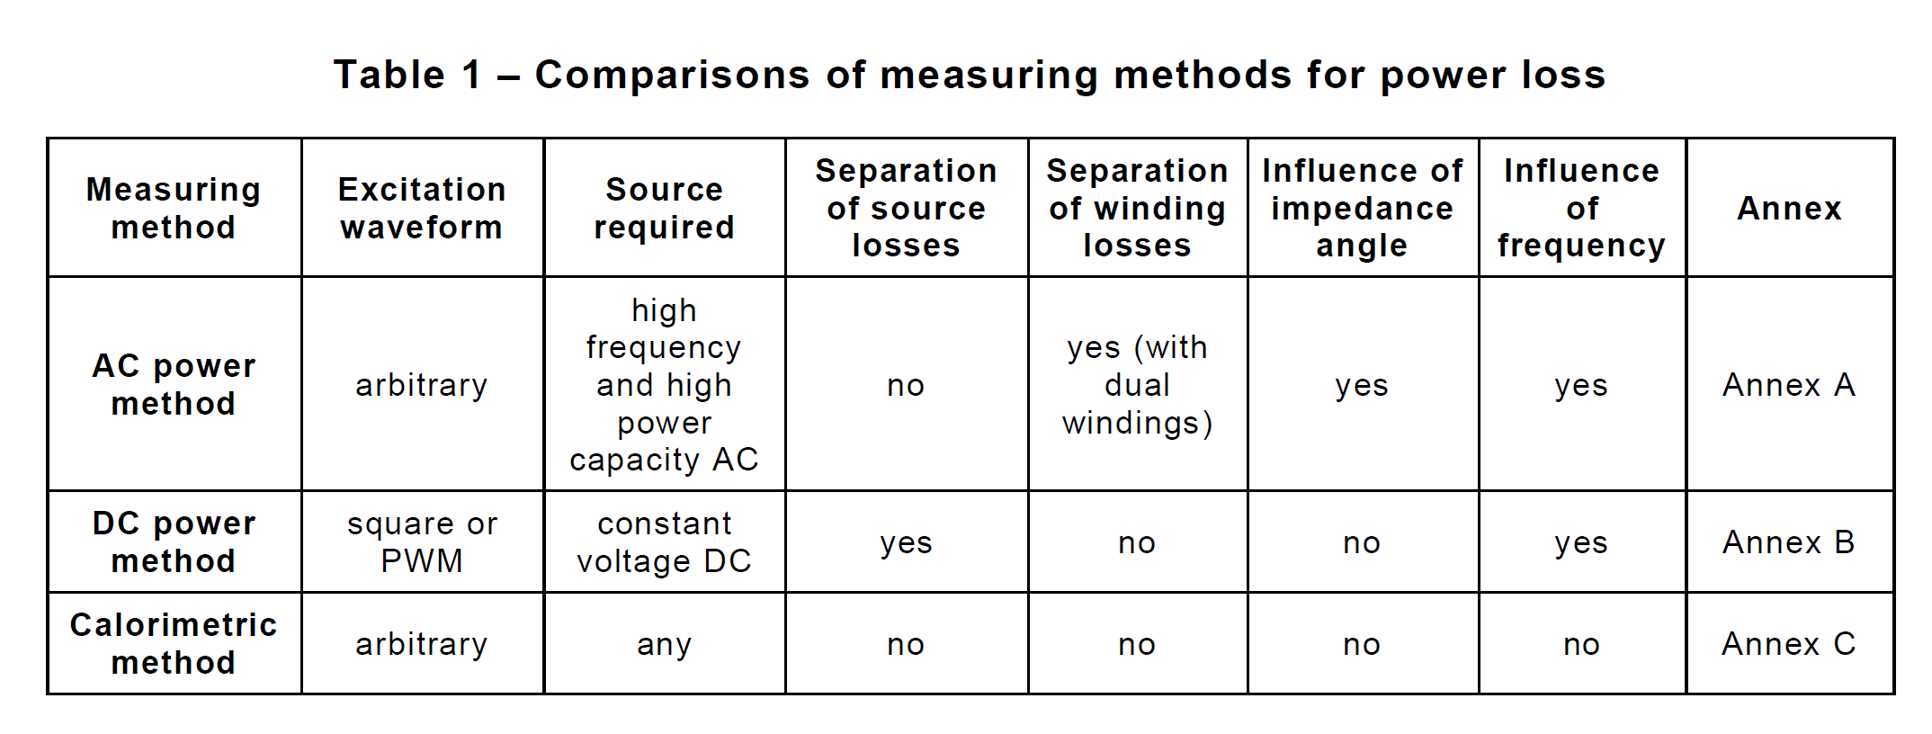
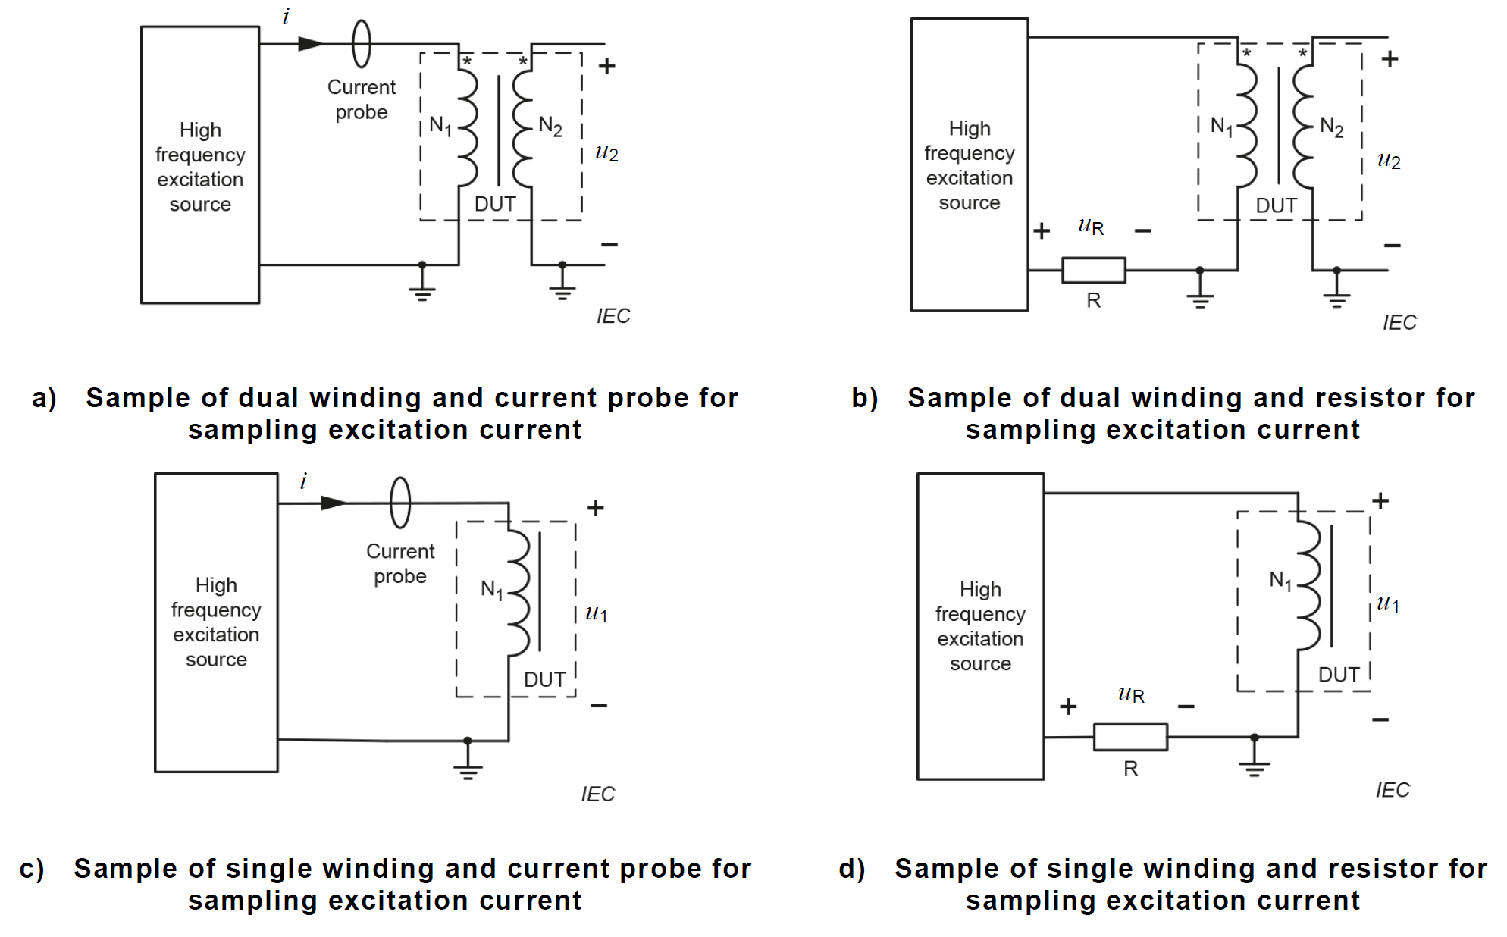
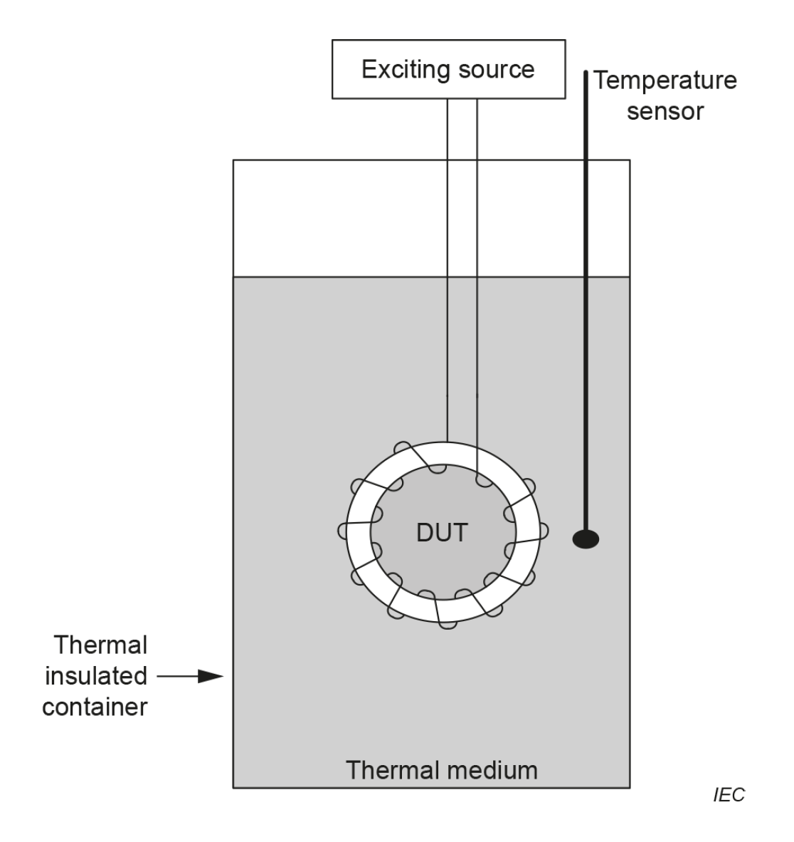
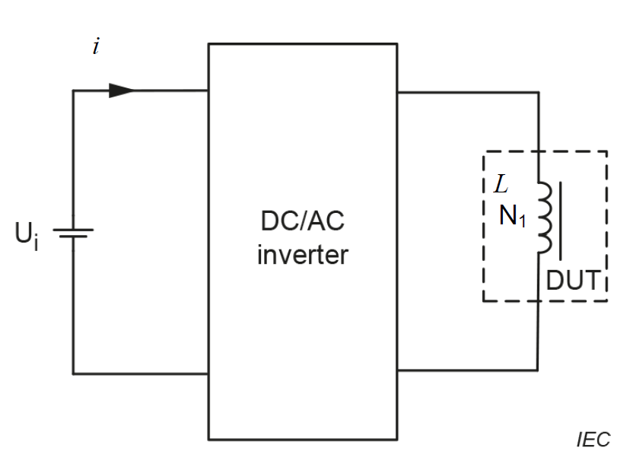
IEC 63300 ED1 (Test methods for electrical and magnetic properties of magnetic powder cores)

Slide 9
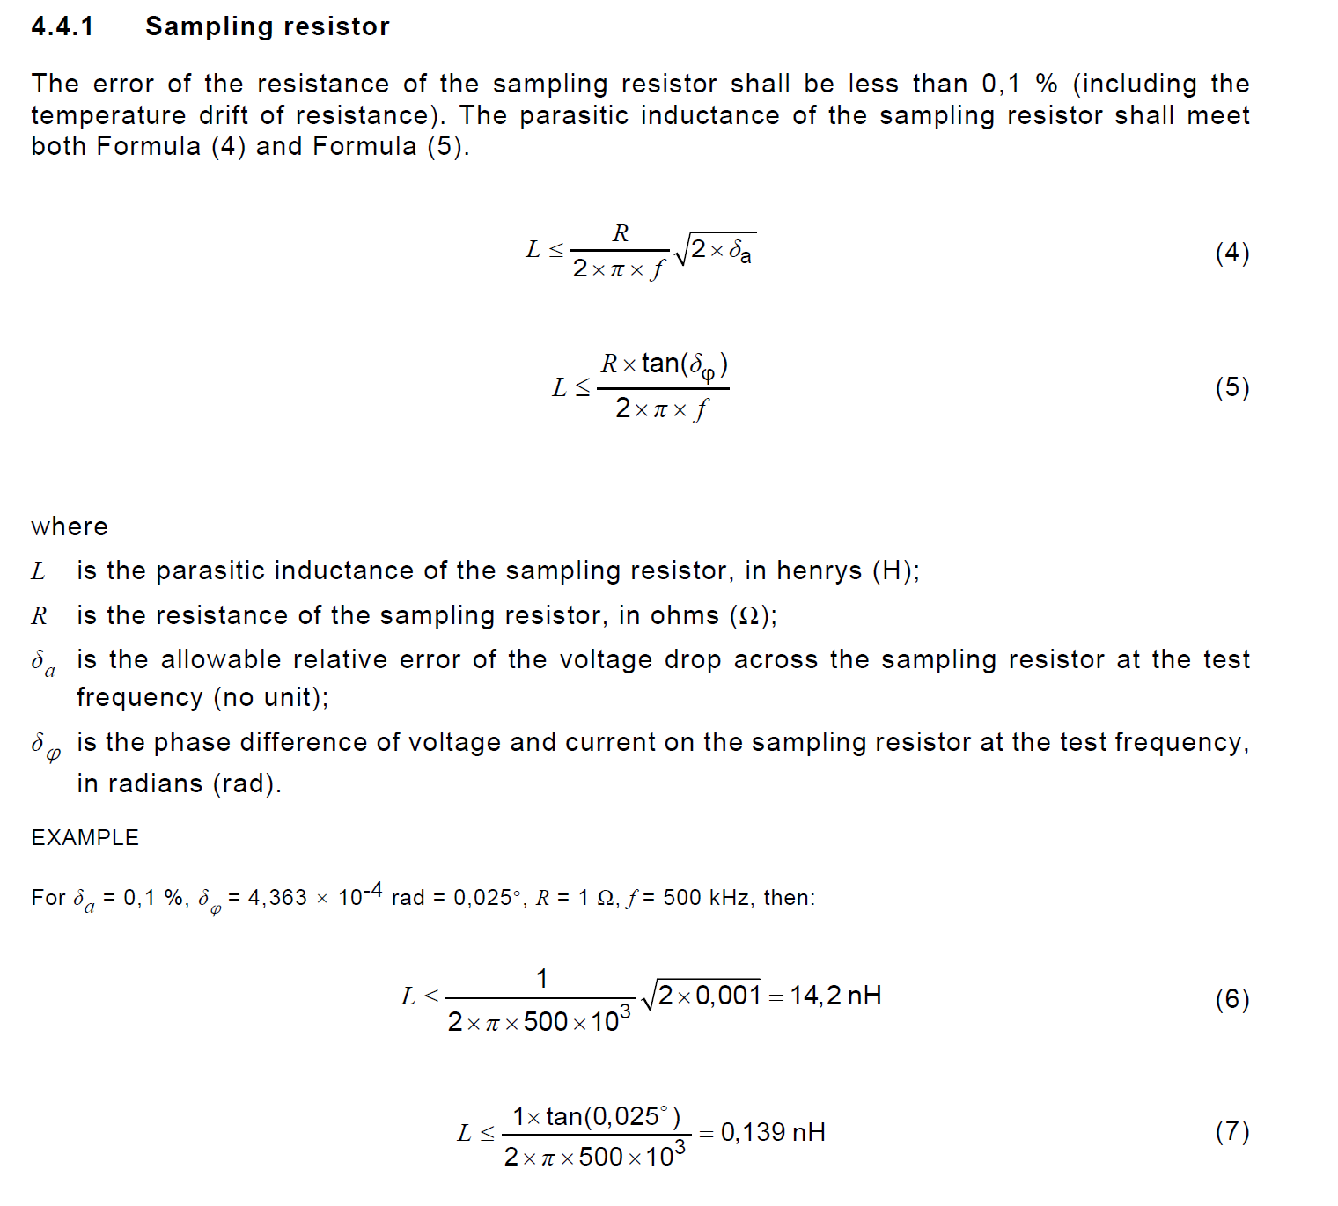
IEC 63300 ED1 (Test considerations for current measuring resistor)

Slide 10
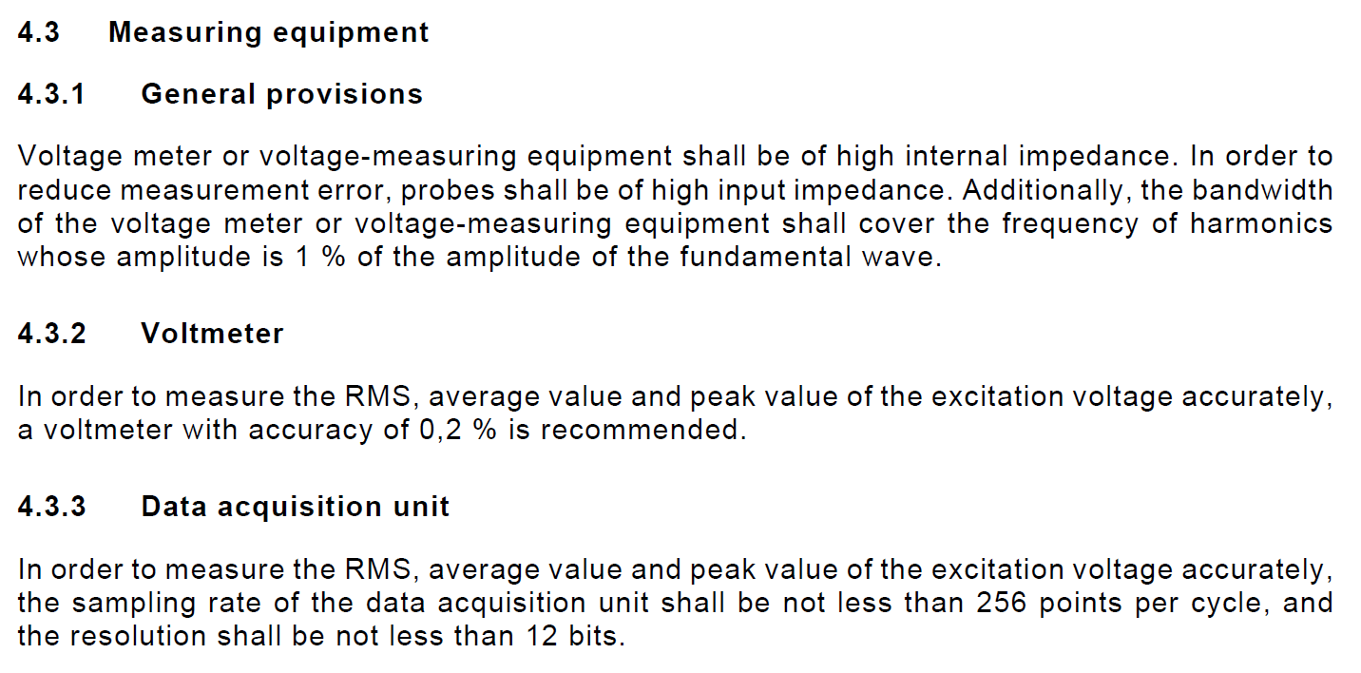
IEC 63300 ED1 (Test considerations for measurement equipment)

Slide 11
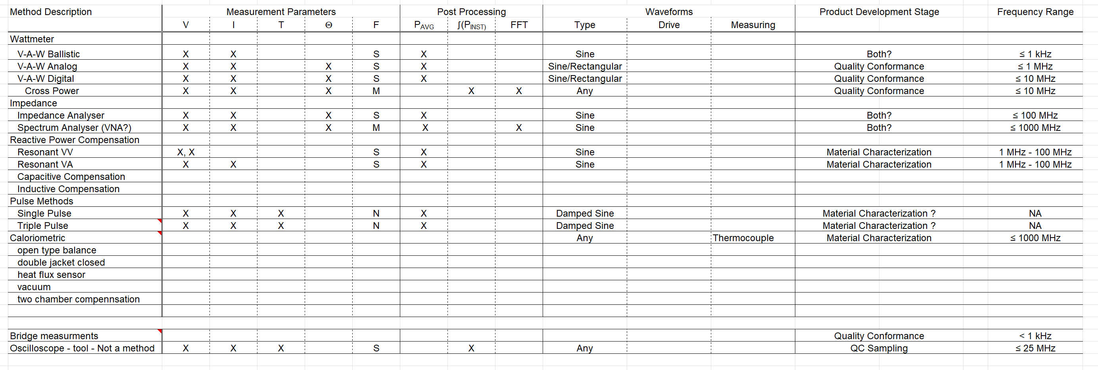
IEEE 393 (Considerations for specific test methods)
Further categorize applicability of test for
Research
Design verification
Product verification
Reliability
Manufacturing

Slide 12
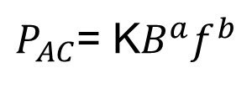
Curve Fits From Measurement Data Ranges (Some Typical Guidelines)
$P_{AC}$= K$B^{a}f^{b}$
Frequency
Target operating frequencies should be within range of measurement frequencies
Including major harmonics
If the raw measurements indicate deviation from linear on log-log plot
Frequency exponent will be encompassing multiple frequency range behaviors
Flux Density – Volt Seconds – Peak to Peak Current
Target operating conditions should be within range of measurement frequencies
If the raw measurements indicate deviation from linear on ln-ln plot
Frequency exponent will be encompassing multiple frequency range behaviors
Bias
Minor Loops in non-linear region of major BH loop have different power loss than minor loops in linear region of major BH loop
Temperature
Maintain constant temperature via
Heat Sink – Verify that heat sink does not impact fringing effects
Forced Air

Slide 13
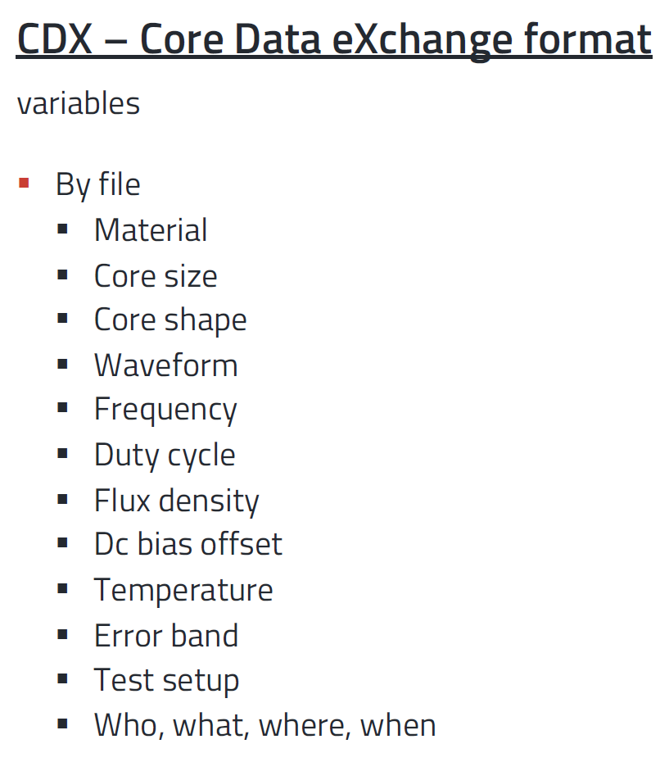
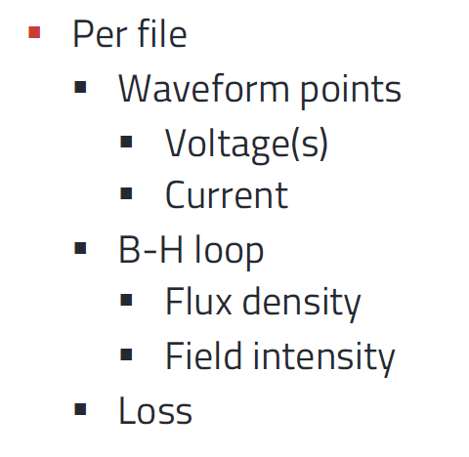
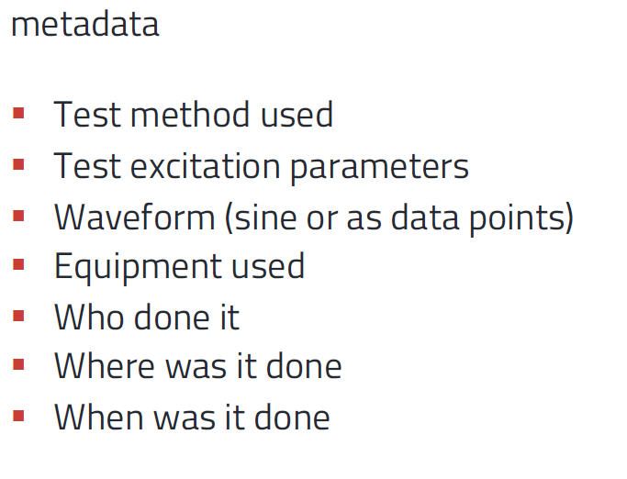
Core Data eXchange Format (CDX) (Proposal in Process)
Test Coil Details
Turns
Wire Size
Winding technique
APEC 2023 Core Loss Measurements for Everyone – George Slama

Slide 14
Magnetic Characterization In General (Publicly Available Reference Information)
PSMA Magnetics Committee Technical Forum
https://www.psma.com/technical-forums/magnetics
Workshop Presentations
2016 Magnetics Workshop
2017 Magnetics Workshop
2018 Magnetics Workshop
2019 Magnetics Workshop
2020 Magnetics Workshop
2021 Magnetics Workshop
2022 Magnetics Workshop
Industry Session Presentations
https://www.psma.com/technical-forums/magnetics/presentations
PSSMA Core Loss Studies
https://www.psma.com/coreloss

Slide 15
Summary
Measurement details are different for material testing, magnetic core testing and magnetic component testing
Magnetic core specifications must be specific to magnetic material, structure, physical dimensions and any intrinsic or introduced physical gap or distributed gap – must reference the test coil
Standard test procedures tend to try to be agnostic relative magnetic materials, magnetic structure and component assembly
However, is circumstances warrant standards, recommended practices or guidelines can be developed for specific materials and structures
Since we are actively updating standards for core loss measurements (cores) and ac power loss measurements (components) – we need your inputs to guide the next releases

Slide 16
ETTC/IEC TC51 (Reference Standards for Core Loss Testing)
Thank You

